Slide 1
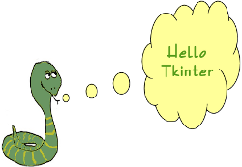
GUI Programming
Tkinter

Slide 2
Tkinter Programming
Tkinter is the standard GUI library for Python. Python when combined with Tkinter provides a fast and easy way to create GUI applications. Tkinter provides a powerful object-oriented interface to the Tk GUI toolkit.

Slide 3
Steps To Create GUI Application
Import tkinter module
Create GUI Application Main Window
Add one or more of the above mentioned widgets to the GUI application.
Enter the main event loop to take action against each event triggered by the user.

Slide 4
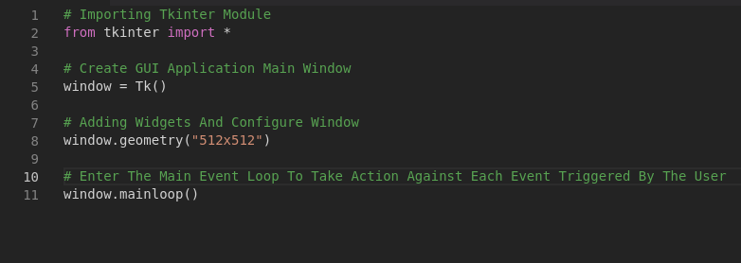
Demo

Slide 5
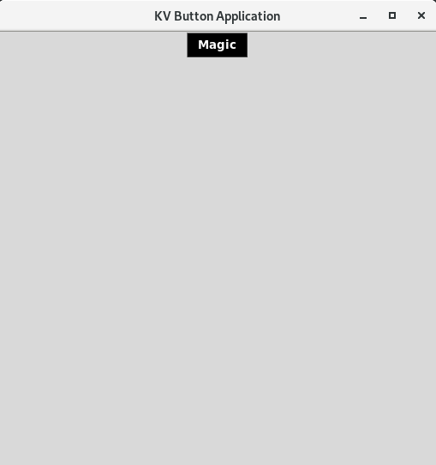
Tkinter :- Button
The Button widget is used to add buttons in a Python application. These buttons can display text or images that convey the purpose of the buttons. You can attach a function or a method to a button, which is called automatically when you click the button.

Slide 6
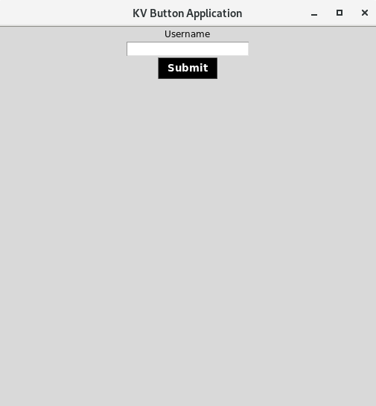
Tkinter :- Entry
The Entry widget is used to accept single-line text strings from a user.
If you want to display multiple lines of text that can be edited, then you should use the Text widget.

Slide 7
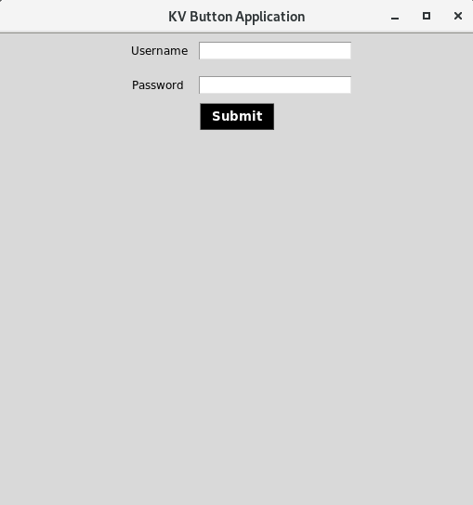
Tkinter :- Frame
The Frame widget is very important for the process of grouping and organizing other widgets in a somehow friendly way. It works like a container, which is responsible for arranging the position of other widgets.

Slide 8
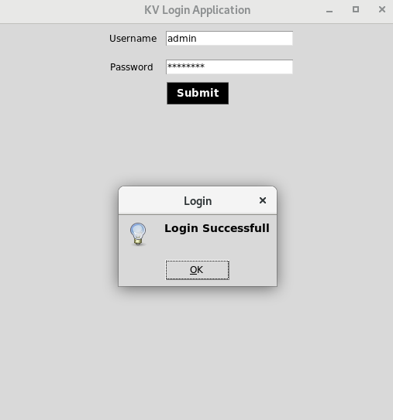
Tkinter :- Messagebox
The tkMessageBox module is used to display message boxes in your applications. This module provides a number of functions that you can use to display an appropriate message.
Some of these functions are showinfo, showwarning, showerror, askquestion, askokcancel, askyesno, and askretryignore.

Slide 9
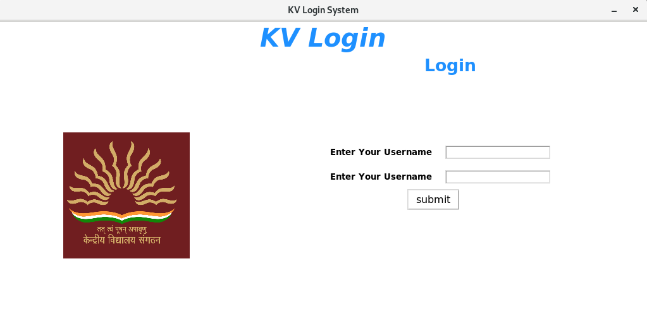
Quick Exercise

